Slide 1

CES’eat
Présentation au client
Mohamed Himeur, Lucas Moniot, Noémie Rappeneau, Omar Sedrati, Axel Vion

Slide 2
Déroulé de la présentation
Introduction et contexte
Rappel du besoin
Présentation du groupe
Organisation du groupe
Développement et Démonstration
Planification
Architecture globale de la solution informatique
Démonstration
Analyse et Conclusion
Analyse des écarts
Bilan projet
Bilan individuel

Slide 3
Introduction et contexte

Slide 4
﻿Rappel du besoin

Slide 5



﻿Présentation du groupe
Juliana Silva
Olivia Wilson
Claudia Alves

Slide 7
Group Project
Presented By : Group Borcelle

Slide 8
Project Overview
Presentations are communication tools that can be used as demonstrations, lectures, speeches, reports, and more. Mostly presented before an audience, it serves a variety of purposes, making presentations powerful tools for convicing and teaching.

Slide 9
﻿Présentation du groupe
Juliana Silva
Olivia Wilson
Claudia Alves

Slide 10
﻿Project Timeline
 | Week 1 | ﻿Week 2 | ﻿Week 3 | ﻿Week 4
Task Name
Task Name
Task Name

Slide 11
Background
General Overview
History
Presentations are communication tools that can be used as demonstrations, lectures, speeches, reports, and more.
Presentations are communication tools that can be used as demonstrations, lectures, speeches, reports, and more.

Slide 12
﻿Project Goals
first
second
Presentations are communication tools that can be used as demonstrations.
Presentations are communication tools that can be used as demonstrations.

Slide 13
﻿Process
Step 1
Step 2
Step 3
Presentations are communication tools that can be used as demonstrations.
Presentations are communication tools that can be used as demonstrations.
Presentations are communication tools that can be used as demonstrations.

Slide 14
﻿Result and findings
Result 1
Presentations are communication tools that can be used as demonstrations, lectures, speeches, reports, and more.
Result 2
Presentations are communication tools that can be used as demonstrations, lectures, speeches, reports, and more.

Slide 15
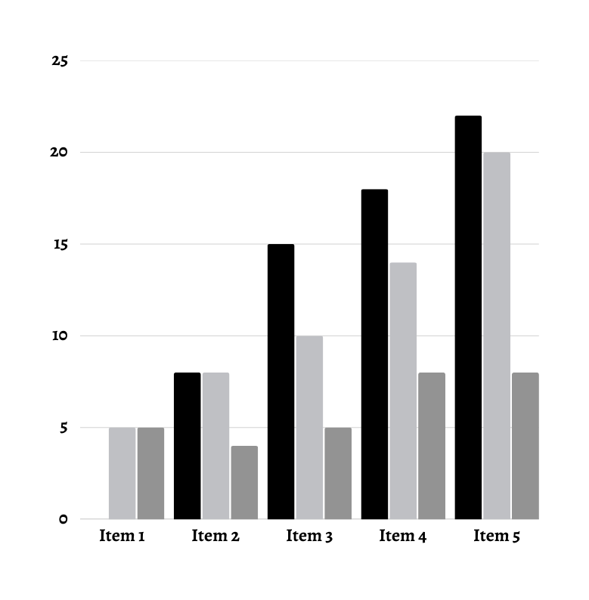
﻿Result and findings
result 1
Presentations are communication tools that can be used as demonstrations, lectures, speeches, reports, and more.

Slide 16
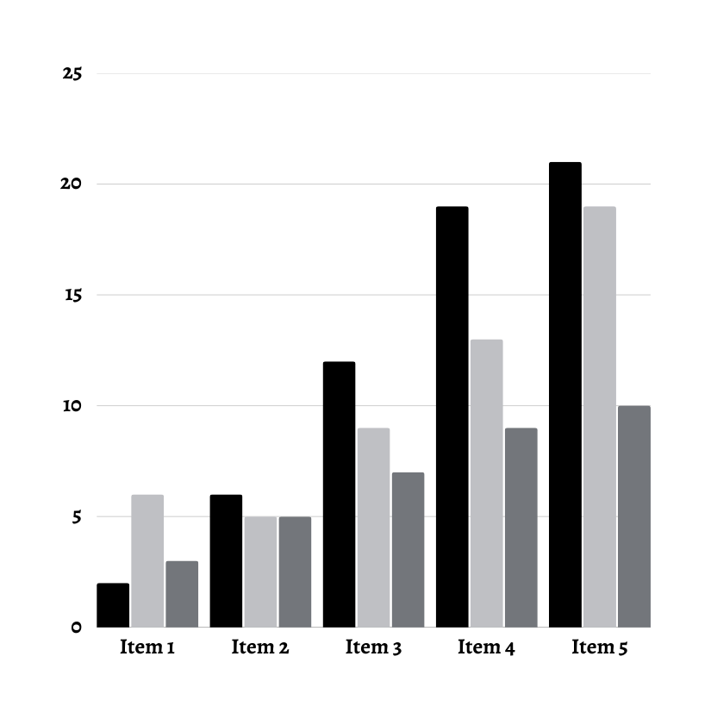
﻿Result and findings
result 2
Presentations are communication tools that can be used as demonstrations, lectures, speeches, reports, and more.

Slide 17
Resources
Link Name : .............................................
Brief Description : ............................................
Link Name : .............................................
Brief Description : ............................................
Link Name : .............................................
Brief Description : ............................................

Slide 18
Conclusion
Presentations are communication tools that can be used as demonstrations, lectures, speeches, reports, and more. Mostly presented before an audience, it serves a variety of purposes, making presentations powerful tools for convicing and teaching.

Slide 19
Does Anyone Have a Questions?

Slide 20
Thank you

